Slide 1



Credit Card Fraud Detection Project
Enhancing security through advanced analytics. Learn how to detect and prevent credit card fraud using data-driven insights.
by KAMBHAM HIMA BINDU

Slide 2
Introduction
Uncover the importance of credit card fraud detection in today's digital world.
Explore the financial and trust implications of fraud for individuals and businesses.

Slide 3

Dataset Overview
Discover the key details of the credit card fraud dataset used in this project.
Explore a dataset of approximately 1.3 million transactions recorded over a two-year period.
Learn about the dataset's source and its generation using the Sparkov Data Generation tool.

Slide 4
Column Details
trans_date_trans_time: Date and time of the transaction.
cc_num: Credit card number (potentially masked for privacy).
merchant: Name or identifier of the merchant involved.
category: Categorization of the transaction (e.g., retail, dining).
amt: Transaction amount.
gender: Gender of the cardholder.
city_pop: Population of the city where the cardholder is located.
job: Occupation or job of the cardholder.
dob: Date of birth of the cardholder.
is_fraud: Binary indicator (0 or 1) for fraudulent transactions.
first and last: The first and last name of the cardholder, providing personal identification details.
street: Street address of the cardholder, contributing to location specifics.

Slide 5

Dataset Summary
Dataset Summary:
Transaction Amount Range:
Rows: 1,296,675
Minimum: $1.0 USD
Columns: 28
Maximum: $28,948.9 USD
Time Range:
City Details:
Start Date: 2019/01/01
Number of Cities: 894
End Date: 2020/06/21
Number of States: 21
Gender Distribution:
Population Range: 23 to 2,906,700
Females: 709,863
Age Constraint:
Males: 586,812
Minimum Age: 18
Merchant Information:
Target Variable:
Number of Merchants: 693
Fraudulent Transactions (is_fraud = 1): 7,506
Transaction Categories : 14
Non-Fraudulent Transactions (is_fraud = 0): 1,289,169

Slide 6

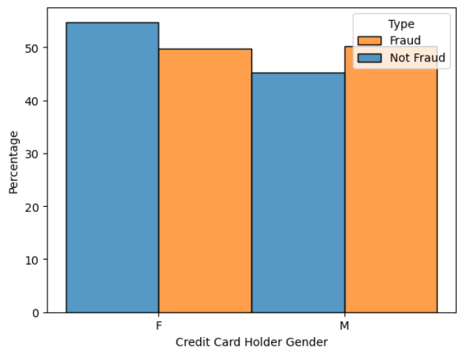
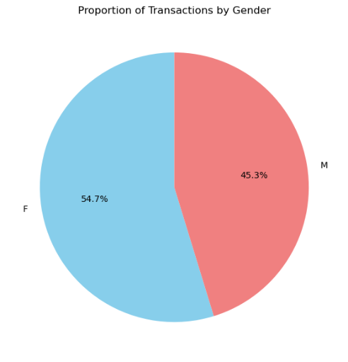
EDA

Slide 7
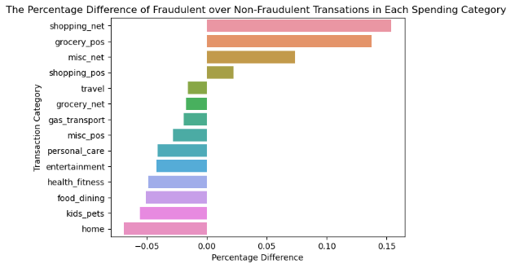
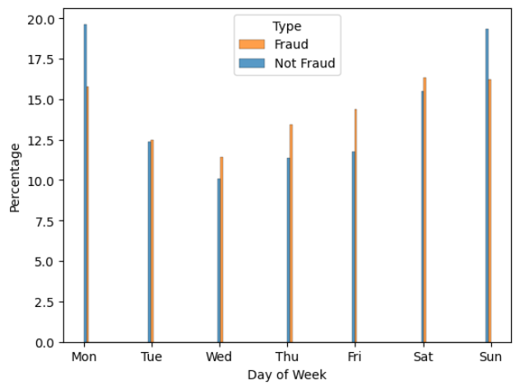

Slide 8

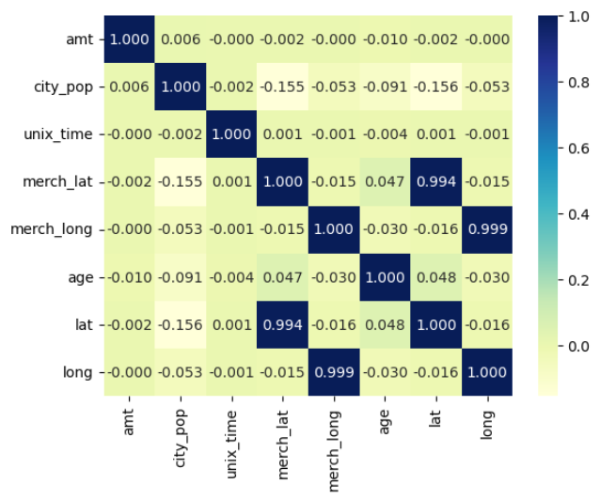

Slide 9

kk

Slide 10

Dataset Features
Get insights into the key features of the credit card fraud dataset.
Analyze transaction volume, involving 1000 customers and 800 merchants.
Explore features such as credit card number, merchant, amount, gender, and more.

Slide 11

Exploratory Data Analysis (EDA)
Gain insights from the visual exploration of the credit card fraud dataset.
Identify patterns, anomalies, and correlations using various charts and graphs.
Examine temporal trends in transaction data to detect potential fraudulent activities.

Slide 12

Numerical Data Analysis
Analyze transaction amounts, ranging from 1 to 28,948.90 USD.
Explore the mean amount of 70.35 USD and the standard deviation of 160.32 USD.
Investigate ZIP codes, coordinates, and city populations for further insights.

Slide 13

Fraud Detection Timeline
1
Dataset Collection
Collect credit card transaction data from various sources.
2
Data Preprocessing
Clean and prepare the dataset for analysis by removing duplicates and handling missing values.
3
Feature Engineering
Create meaningful features from the raw data to improve fraud detection accuracy.

Slide 14

Next Steps
Model Training
Model Evaluation
Train machine learning algorithms on the prepared dataset to detect fraudulent transactions.
Evaluate the performance of the trained models using appropriate metrics and validation techniques.
Deployment
Implement the fraud detection model in real-world scenarios to enhance security and prevent financial losses.

Slide 15
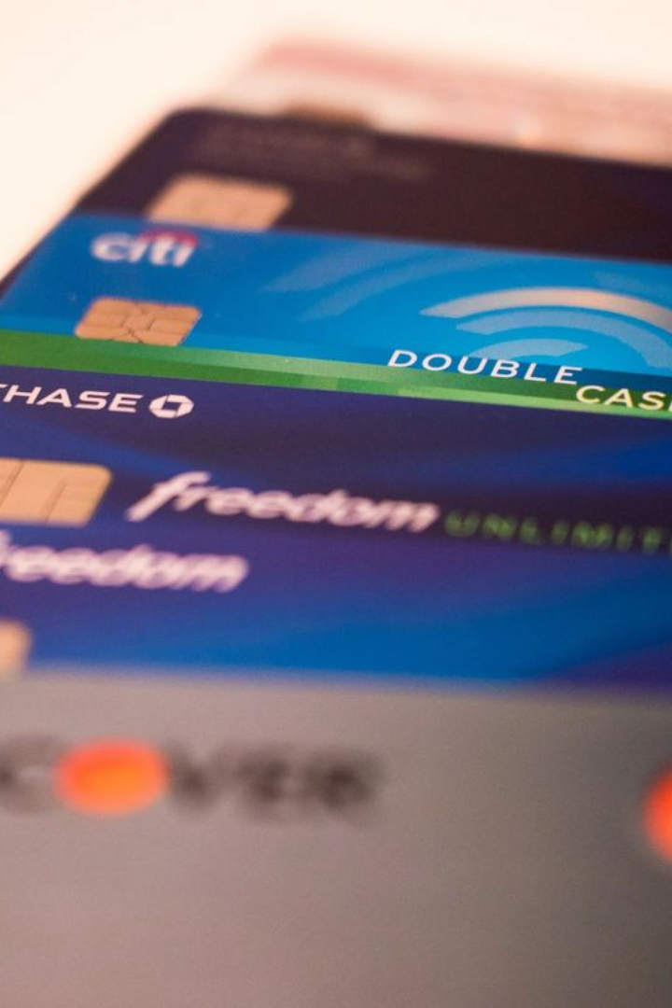
Determining the Objective
Problem Statement: Credit Card Fraud Detection
Objective: Develop ML model, Conduct Cost-Benefit Analysis, Provide Recommendations

Slide 16
Summary Statistics Interpretation
Transaction Amount (amt):
Ranged widely from 1 to 28,948.90 USD.
Mean amount: 70.35 USD, SD: 160.32 USD.
75% of transactions below 83.14 USD.
ZIP Code (zip):
Diverse values with a mean of 48,800.07.
Geographic Coordinates (lat and long):
Broad geographical spread with mean lat: 38.54, long: -90.23.
City Population (city_pop):
Significant variation, mean: 88,824.44, max: 2,906,700.

Slide 17
Categorical Data Analysis
Merchant Information:
Various merchants with "fraud_Kilback LLC" having the highest frequency.
693 unique merchants in the dataset.
Transaction Categories:
Various categories with "gas_transport" having the highest frequency.
"Travel" category with the fewest transactions.
Transaction Amount Subset:
Examined a subset with entries ranging from 1.06 to 1,376.04 USD.

Slide 18
Model Building
Models Used:
Logistic Regression, Random Forest, XGBoost, Decision Tree.
Performance Metrics:
Accuracy, Precision, Recall, F1-Score.
Random Forest Model:
Achieved an accuracy of 99.78% with a precision of 94% and recall of 75%.

Slide 19
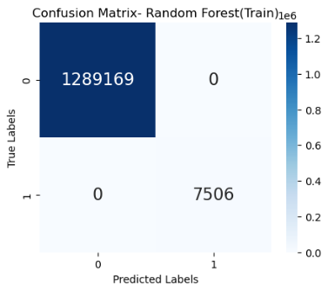
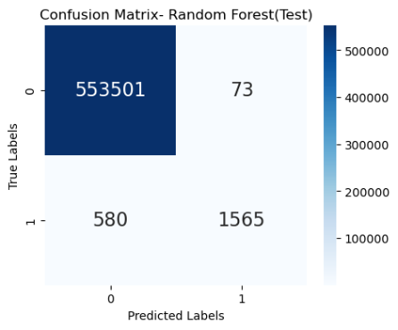
Evaluation Metrics
Random Forest Metrics: Accuracy, Precision, Recall, F1-Score
Accuracy of Train Data: 100.0
Accuracy of Test Data: 99.88249457009748
True Positive Ratio : 72.96037296037296
False Positive Rato : 0.013187035518286623
Precision : 95.54334554334555
F1 - Score : 82.73856727464975

Slide 20
Feature Importance
Top Features:
log_amt (Logarithm of Transaction Amount)
category_grocery_pos
category_misc_net
category_shopping_net
category_travel
Insights:
Unusual log-transformed amounts flagged for potential fraud.
Certain spending categories show higher susceptibility to fraud.

Slide 21

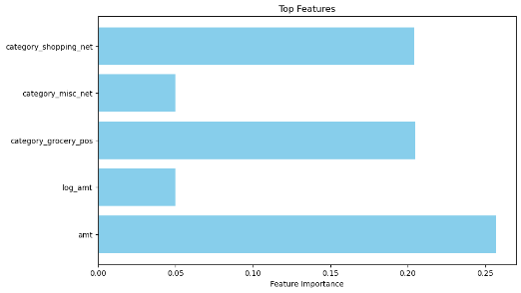
kkk

Slide 22

Strategic Approach

Slide 23

Proposal: Biometric Confirmation
Introducing Fingerprint Authentication can provide numerous benefits for secure user verification. Our implementation strategy ensures a seamless experience while providing an extra layer of security. Advantages include faster login times and reduced risk of password breaches.

Slide 24

Benifit

Slide 25
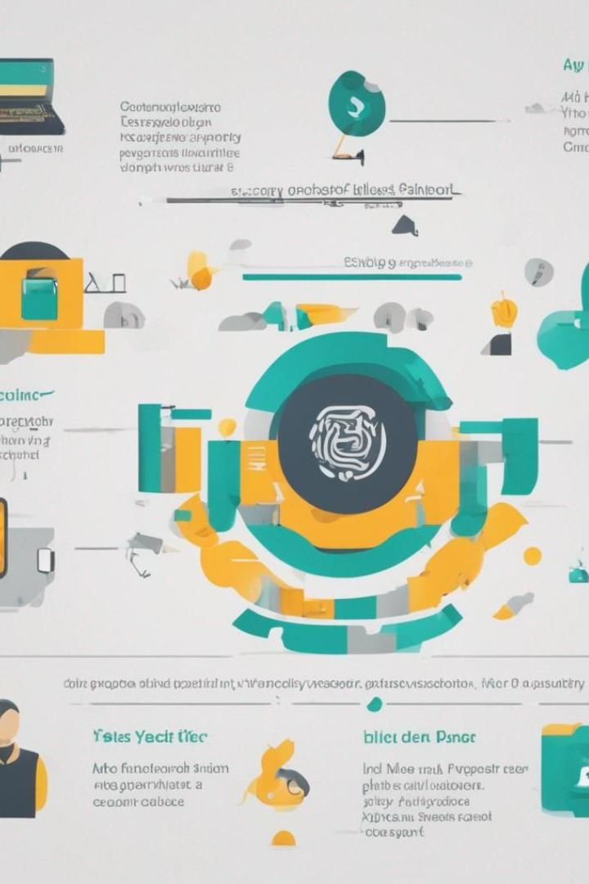
Proposal: Two-Step Verification
Considering the vulnerability of elderly customers to fraudulent activities, our Two-Step Verification system combines iris and fingerprint recognition for enhanced security. It offers advantages such as enhanced security, user-friendly experience, and accessibility features. Implementation steps include customer engagement, education campaign, enrollment support, test phase, gradual rollout, and continuous support.

Slide 26
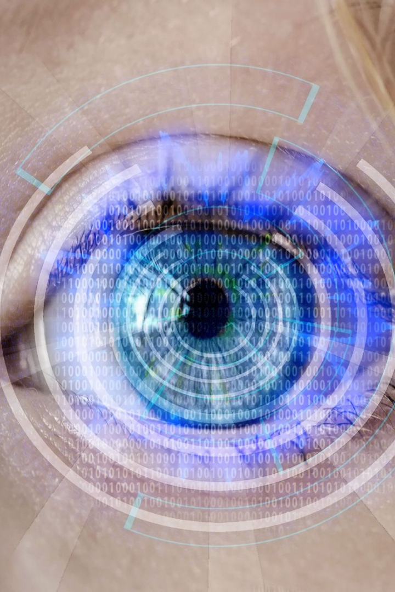
Proposal - Two-Step Verification
Background: Elderly customers are often targeted by fraudulent activities.
Two-Step Verification: Combines iris and fingerprint recognition for enhanced security.
Advantages: Enhanced Security, User-Friendly, Accessibility Features.
Implementation Steps: Customer Engagement, Education Campaign, Enrollment Support, Test Phase, Gradual Rollout, Continuous Support.

Slide 27

Adavantage

Slide 28


Slide 29


Slide 30


